Slide 1
Fast Queue Sampler Project
Zuher Jahshan, Maher Sanalla
Supervisor: Roy Mitrany

Slide 2
AGENDA
PROJECT GOALS
OUR APPROACH
LINUX QUEUING SYSTEM
SIMULATION
EVALUATION
CONCLUSION
Notes:
OUR APPROACH( RESEARCH MORE THAN IMPLEMENTATION)
LINUX QUEUING SYSTEM ( EXPLAIN THE IMPORTANCE OF UNDERSTANDING LINUX TO USE OUR SILUTIN)
SIMULATION ( AS ITS NAME)
EVALUATION ( ANALZUYING)
CONCLUSION.L..

Slide 3

Notes:
OUR APPROACH( RESEARCH MORE THAN IMPLEMENTATION)
LINUX QUEUING SYSTEM ( EXPLAIN THE IMPORTANCE OF UNDERSTANDING LINUX TO USE OUR SILUTIN)
SIMULATION ( AS ITS NAME)
EVALUATION ( ANALZUYING)
CONCLUSION.L..

Slide 4
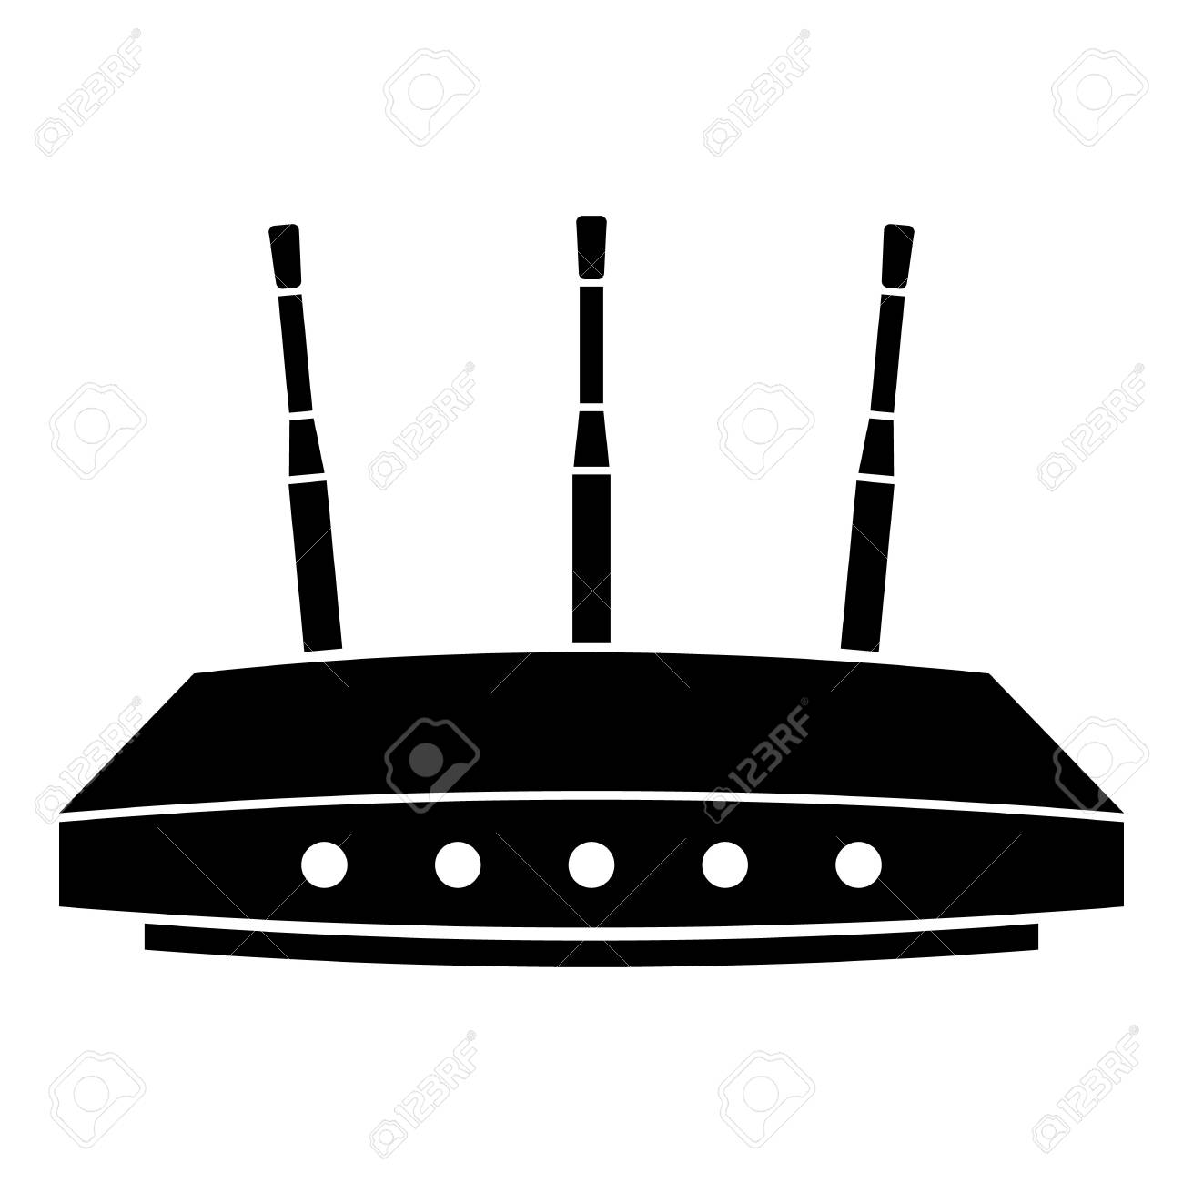

Notes:
Now, assume that many clients want to communicate with some server, they obviously cannot synchronize the timings of the messages they send to the server.
The router, as a connection point between those many clients to the server, must transmit the data to the server. the problem is, the transmission rate between the router and server is not as fast as the rate of the arriving packets to the router. Therefore, the router can simply throw packets, or he can maintain some “waiting station”. It is obvious that maintaining some waiting station is much more beneficial (for example, you don’t want to drop a packets that traveled from far away!).
Hence, transmission queues to control the transmission of packets is needed.

Slide 5


Main GOAL
Notes:
Our main goal is to sample those transmission queues (TX) at a very high rate, a rate such a single arrival or departure of a packet to the TX could be detected.

Slide 6


System chosen
Ubuntu Linux 5.3.0
Notes:
So, to investigate on a way to sample the queue, first you need to know where to investigate.
Every OS implements the TX in a different way.
We chose to investigate the maintenance of the TX in ubuntu-linux 5.3

Slide 7
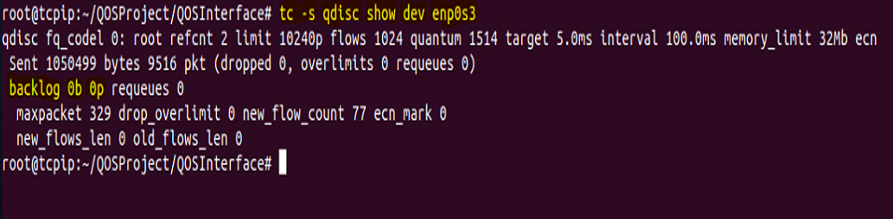
Existing tools
Traffic Control (TC)
Notes:
First step in our investigation included searching for some existing tools, we found a subsystem provided by Linux, named TC.
TC provides a large set of functionality to manipulate and control the transmission queues, but importantly, it provides a way to query the queue and recieve its stats.

Slide 8

Problem with tc
Notes:
Two many forks, every time a sample is taken, a fork system call is invoked, that gives an enormous overhead for simply sampling the queue.
So, suppose we wanted to sample the queue for a duration of 30[s], in succession. Then, it is obvious that we spend an enormous amount of time doing fork, instead of sampling.

Slide 9
A fast-sampling tool is needed
OUR APPROACH
Research
Research
Research
Implement
Test
Notes:
So, with Roy consent, we chose a beautiful path:
Our approach, was to understand how transmission queues are handled and maintained in Linux.
Let us share with you our findings…

Slide 10

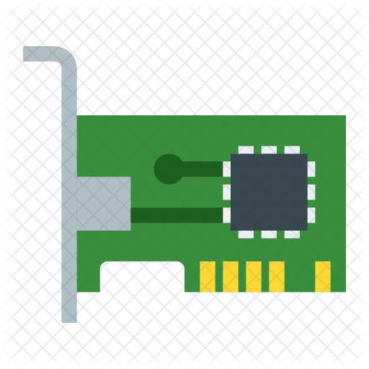

NIC
Network Interface Controller
Notes:
Inside of a computer, there are a different kinds of computer hardware components that are built for the sake of different objectives.
As you all know, the Network Interface Controller (NIC) has the objective of connecting a computer to the network and handle all the networking subsystem.

Slide 11


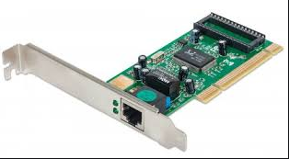
The net device
net_device
NIC
KERNEL SPACE
Notes:
Linux OS maintains a special data structure called the net_device.
The DS defines an instance of a network interface.
It tracks the state information of all the network interface devices attached to the TCP/IP stack.

Slide 12
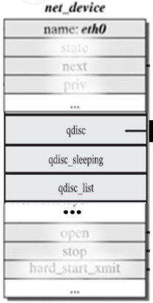
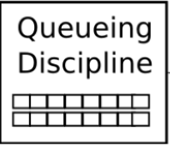
NET_DEVICE STRUCT
Notes:
net_device is the only connection between kernel space and NIC itself.
So, we decided to research the net_dev and look for clues about queues.
We found out that net_dev->qdisc is a DS responsible to determine how the output network packets are arranged in queues and transmitted

Slide 13
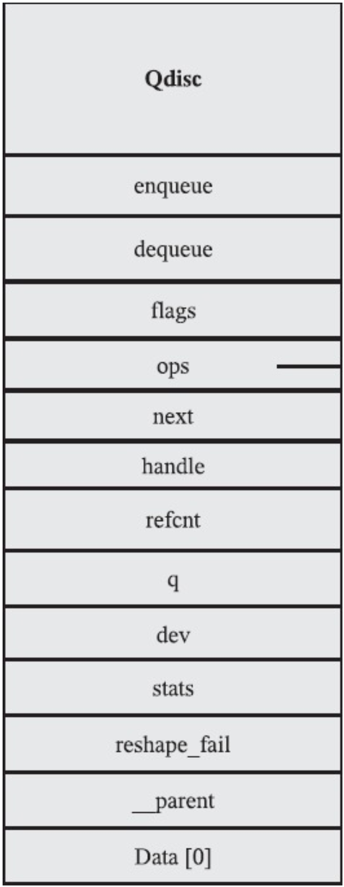
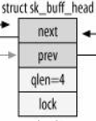
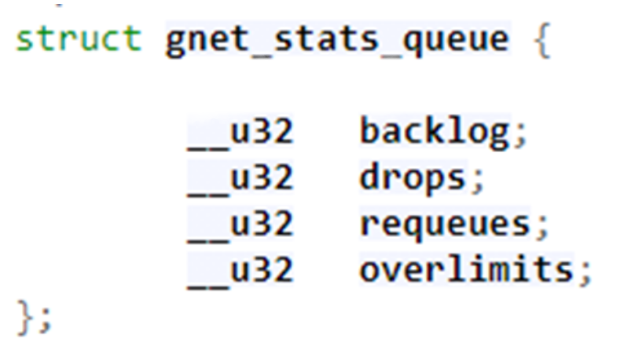
QDISC
Notes:
The DS that actually saves packets is a list. It contains sk_buff’s
Sk_buff is DS in kernel that represents network packet. (packet==sk_buff)
Sk_buff_head is a pointer to the head of sk_buff’s list
Sk_buff_head struct has a member called qlen that contains the number of packets in the list.

Slide 14
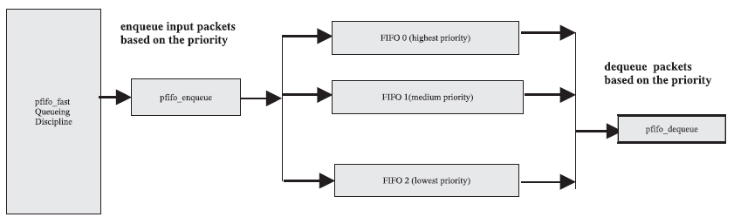
Default qdisc (pfifo)
Notes:
Pfifo is one implementation of qdisc – it is the default qdisc implementation used in Linux

Slide 15
ALGORITHM
Sk_buff_head
Sk_buff_head
next
next
qlen = 52
qlen = 13
Counter = 52
Counter = 65
Counter = 0
Notes:
Pfifo is one implementation of qdisc – it is the default qdisc implementation used in Linux

Slide 16
Pfifo_fast Queuing Discipline
Notes:
pfifo_fast contains three different FIFO queues based on priority, as seen in Fig. 1(b). The highest priority packets go into FIFO0, and these highest packets are dequeued first before handling any packets in FIFO1 and FIFO2. Similarly, packets in FIFO1 are considered first before any packets handling in FIFO 2.

Slide 17
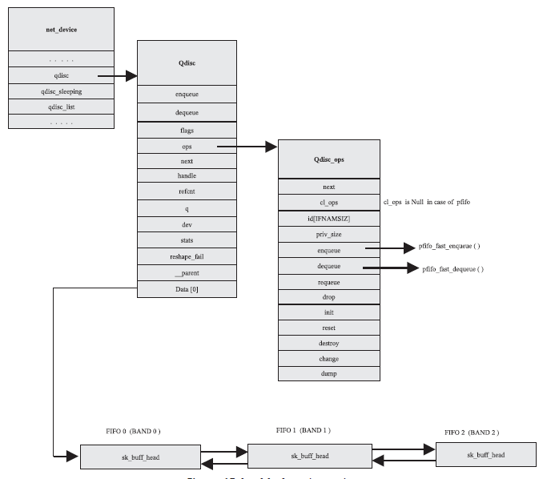
net_dev
Notes:
Each network interface is defined by struct net_device. This structure has call-back routines specific to hardware. When the module is installed for the network card, the net_device object is initialized with device-specific call-back routines and certain parameters in the init routine. The qdisc data structure of the net_device represents the queueing discipline for that network interface. It contains Qdisc:data i.e., pointer to the packet list head inside the queue, In the case of default pfifo_fast, this points to an array of sk_buff_head structures as seen in the figure above.

Slide 18
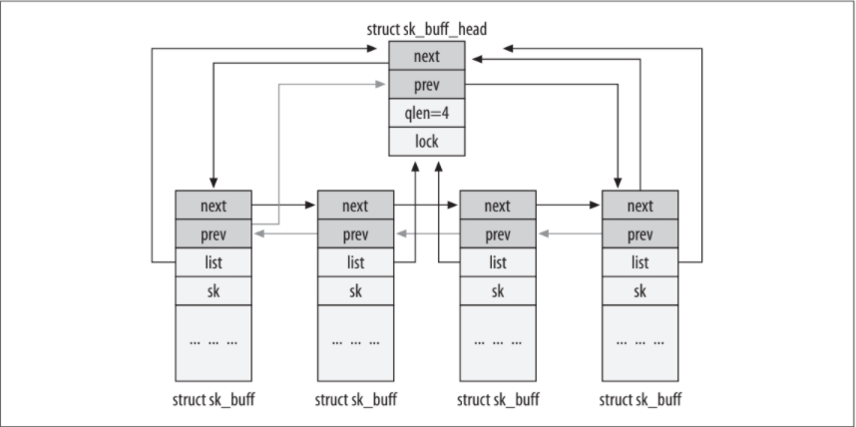
sk_buff
Notes:
sk_buff_head is simply a list head as described in the previous figure.
Finally, sk_buff represents the packet structure on Linux. Thus, the number of packets under a certain sk_buff_head is exactly sk_buff_head::qlen.

Slide 19

Implementation
Sample Request
FQS
Eth0
net_dev
User
FIFO0
Qdisc
FIFO1
FIFO2

Slide 20

How to access Kernel infrastructure?
Notes:
Previously shown DS are all inside the kernel – thus to reach them we must access kernel internal data

Slide 21

OUR APPROACH
Building a new System call?
requires kernel compilation
Less portable
Alternative Solution:
Modules

Slide 22
using kernel modules
Problems:
Passing Parameters:
net_device name (eth0/wlan0…)
pid
Solution:
sysfs
Notes:
Passing the net_dev name from user space to kernel space to provide functionality of collecting information about all types of net_devices to unprivileged user
The need for pid is related to entowrk namespaces (will be elaborated furthermore later on)

Slide 23
Sysfs
sysfs is a pseudo file system provided by the Linux kernel.
It exports information about various kernel subsystems (in our case the Qdisc) from the kernel's device model to user space through virtual files.

Slide 24
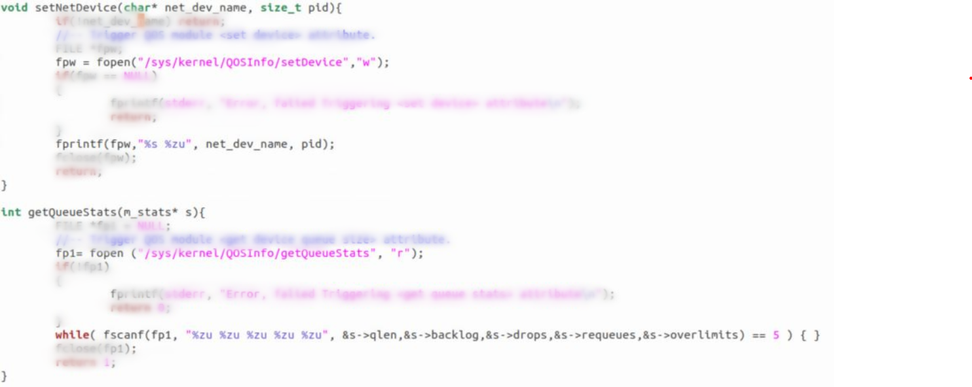
Sysfs INTERFACE
Notes:
setNetDevice defines which net_device we want to collect info and data from
getQueueStats returns the stats and info about the net_device that was previously set by calling setNetDevice
Pid is important to define from which network namespace are we entering this net_device (from Machine A or Machine B or ….)

Slide 25
Simulation
We tested FQS performance using Mininet.
We used Ubuntu Linux environment with:
6 processor cores
8[GB] RAM.
1-100 Clients
1 Server
1 Router
Notes:
We used both tools, our FQS and the known TC on the router’s environment to check the router transmission queue size over time. In both cases, we used Python scripts that continuously sampled the queue for a duration of 3 minutes.
MININET!
Interface
To test our FQS we built a virtual environment/topology using Mininet and sampled the router’s Tx queue using both FQS and TC.
Compared and analyzed the results ---- proved the capability of FQS to capture single queue event

Slide 26
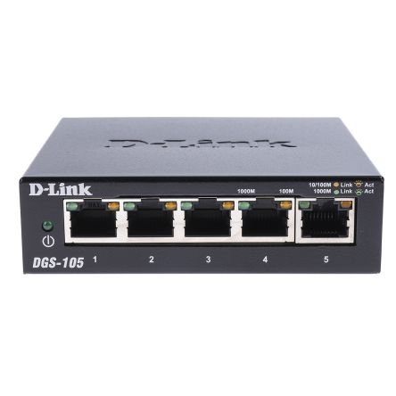
Router
Switch
Server
.
.
.
FQS
Notes:
N clients where N is a variable between 1 and 100

Slide 27
Mininet network stack
Mininet provides a virtual network stack (i.e., network namespace) per each end-point.
Every virtual end-point lives under a different process.
Every process has a different network namespace.
Since net_device is associated with a unique network namespace
To access a net_device, pid is needed.
Notes:
Network namespace is a subsystem that linux provides to the sake of virtualizing network stacks

Slide 28

network namespace
Client1
Network Namespace
pid=11453
net_dev: router-client1
Client2
Network Namespace
pid=2312
What is the Router-server Queue stats?
FQS
net_dev: router-client2
Network Namespace
Pid=11320
Router
net_dev: router-server
net_dev: router-client1
net_dev: router-client2
Notes:
Visualization to the thing mentioned earlier

Slide 29


Sampling
We used Python scripts that continuously sampled the queue for a duration of 3 minutes.
While sampling – the output was not printed immediately to the user. Rather it was stored into a buffer – that was printed only when full
Results were collected and visualized using MATLAB.

Slide 30
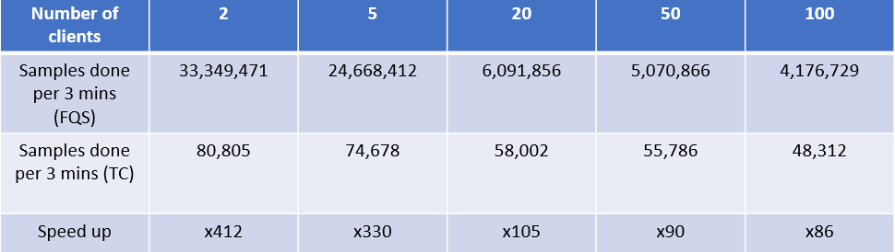
FQS vs. TC (speed up)
Notes:
The FQS was able to catch queue events more clearly
FQS samples represented a more refined partition of the test-interval
The frequency of FQS samples - 200K samples per second (i.e., a sample every 5[$μ$s])
The frequency of TC samples - 0.5K samples per second (i.e., a sample every 2[ms])
Number of clients $↑$ $→$ Sample's throughput $↓$
33 million samples drops to only 4 million
More clients → more processes on CPU → More context switches
The FQS/TC speedup decreased as the number of clients rose

Slide 31
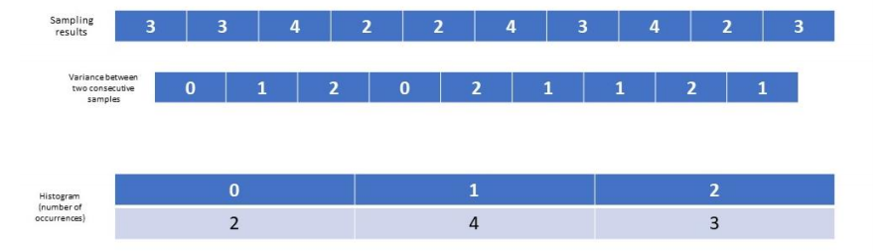
Variance between two consecutive samples
Notes:
*Explain our performance aspect (figure of merit) that we calculated to represent sampler efficiency

Slide 32
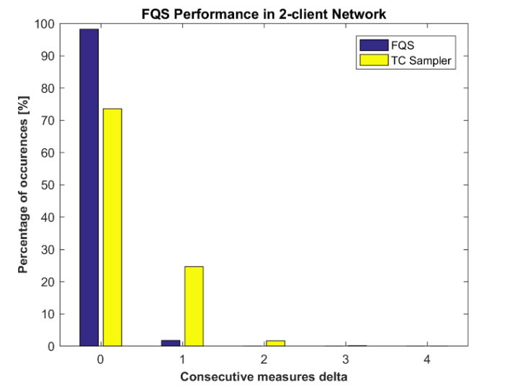

Slide 33
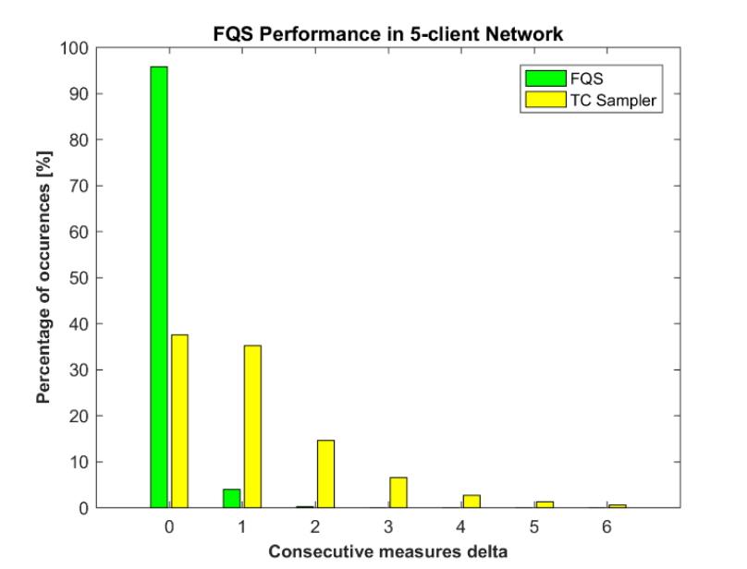

Slide 34
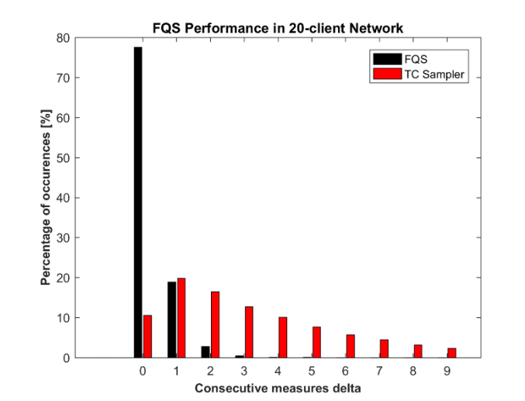

Slide 35
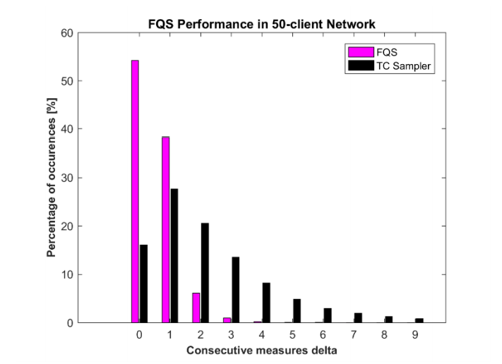

Slide 36
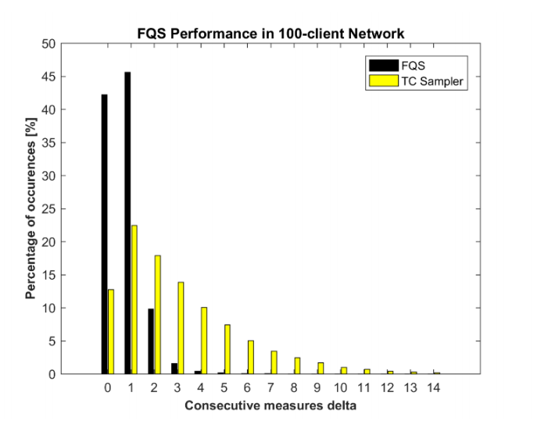

Slide 37
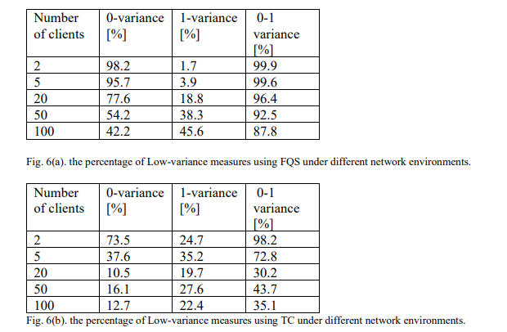
Summary
FQS Results
TC Results

Slide 38
Conclusion
We presented a network transmission queue sampling tool that is equivalent to the Linux own TC
We tested the performance of the FQS vs TC by simulating traffic through a virtual network
We processed and analyzed the results
FQS is significantly more efficient than TC

Slide 39
Future Work
Upgrade the FQS to support more Qdisc types
CBQ (Class-Based Queue)
TBF (Token-Bucket Filter Queue)
Extend the interface to collect other info from the Queue/Net devices
ECN bit

